Slide 1

Project 1
Real Estate
Understanding the Influences upon Property Prices in Melbourne
Presented by:
Kali Notaras
Keerthi Chippa
Basudeb GhosH
Aayush Gupta
Christopher Banh

Slide 2


Project Description & Outline
Melbourne Property Price Insights
For Buyers:
For Sellers:
Key attributes influencing Property Prices
Insights per Living Demographic
Refined pricing estimates
Evaluate the performance of Melbourne’s top real estate agencies.

Slide 3
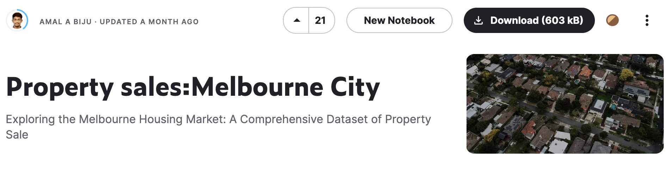
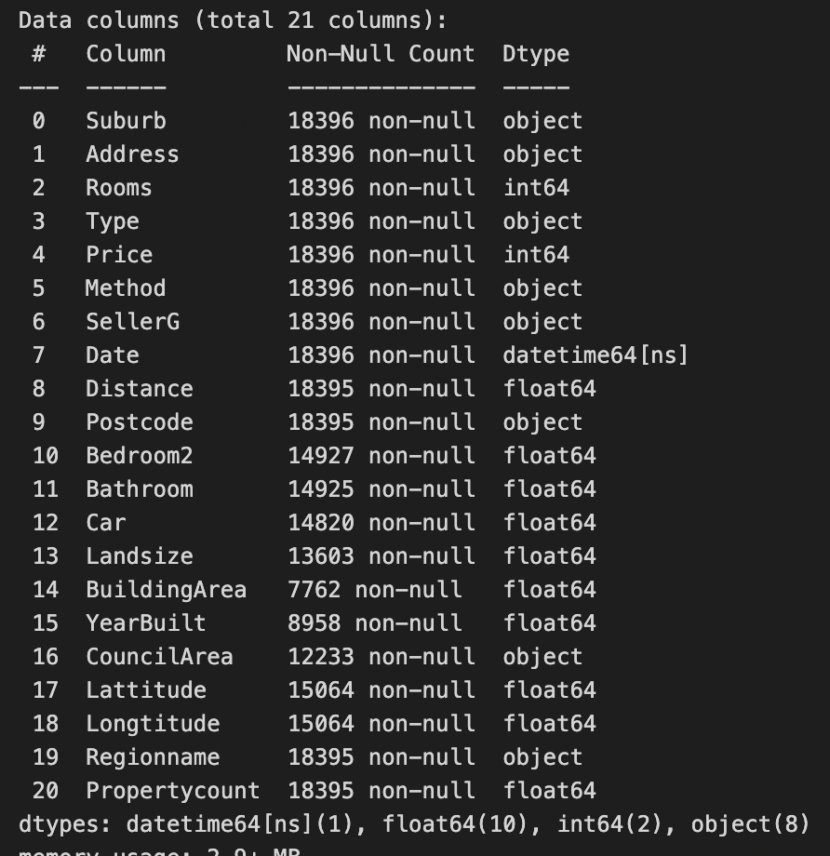
Dataset & Initial Data Cleaning
Source: Data generated by Biju, A.A. (2023). Property sales:Melbourne City.
Accessed on 4 April 2023. URL: https://www.kaggle.com/datasets/amalab182/property-salesmelbourne-city
Cleaned Dataset
21 Columns
18,396 Rows

Slide 4
QUESTION 1.
What are the main influences on Property Prices in Melbourne?

Slide 5
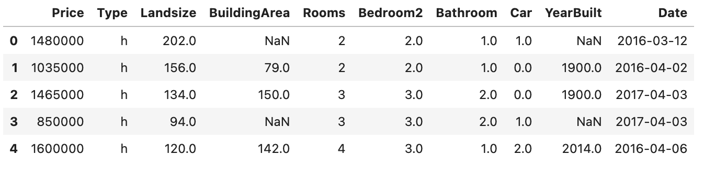
QUESTION 1.
Data Exploration & Cleaning
Dependent Variable
Price
Number of Bedrooms
Number of Bathrooms
Parking Spots
Year Built
Date of Sale
Independent Variables
Property Type
Land Size
Building Size
Rooms

Slide 6
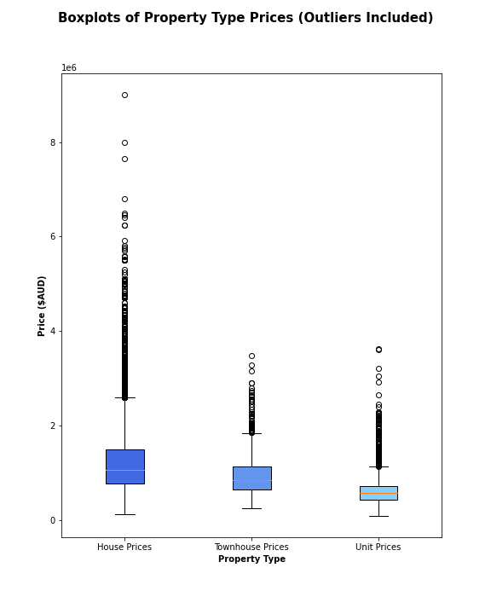
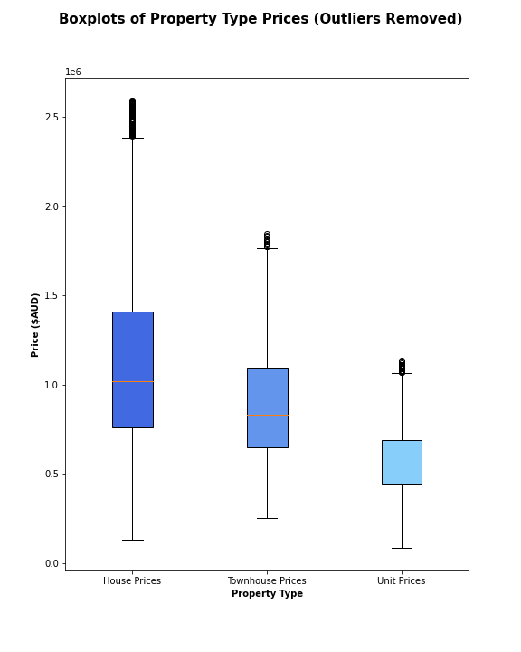
QUESTION 1.
Data Analysis: Property Type

Slide 7
QUESTION 1.
Conclusion
Results
Assumptions
Hypothesis Testing
T-Test

Slide 8
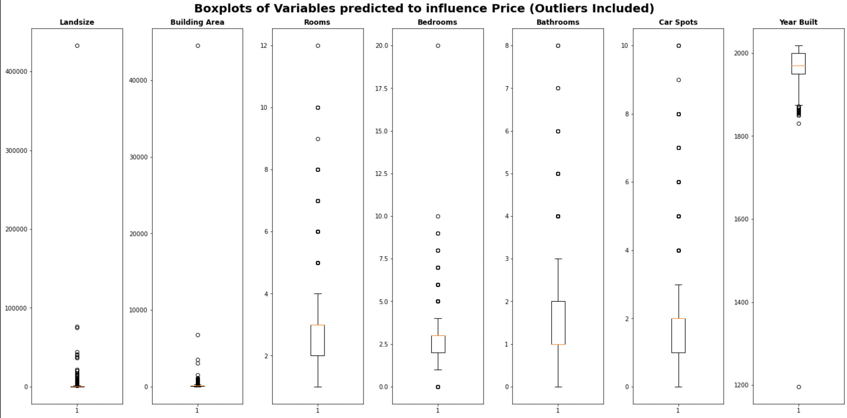
QUESTION 1.
Data Analysis: Dependent Nominal Variables

Slide 9
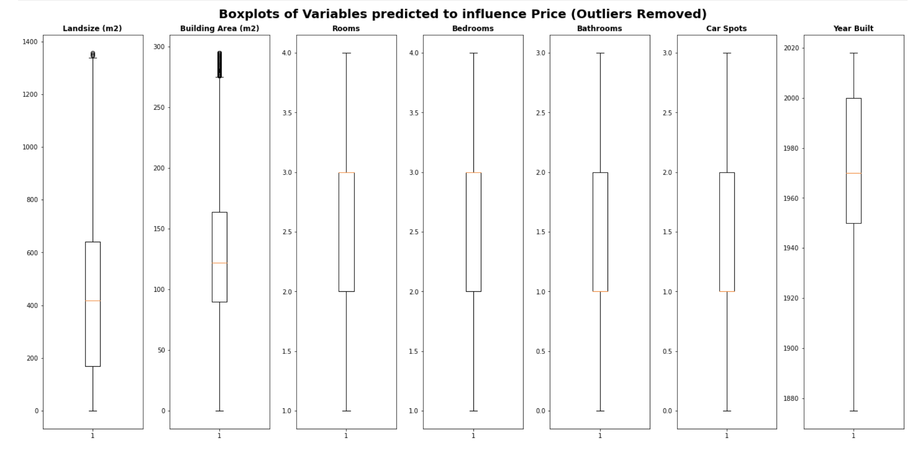
QUESTION 1.
Data Analysis: Dependent Nominal Variables

Slide 10
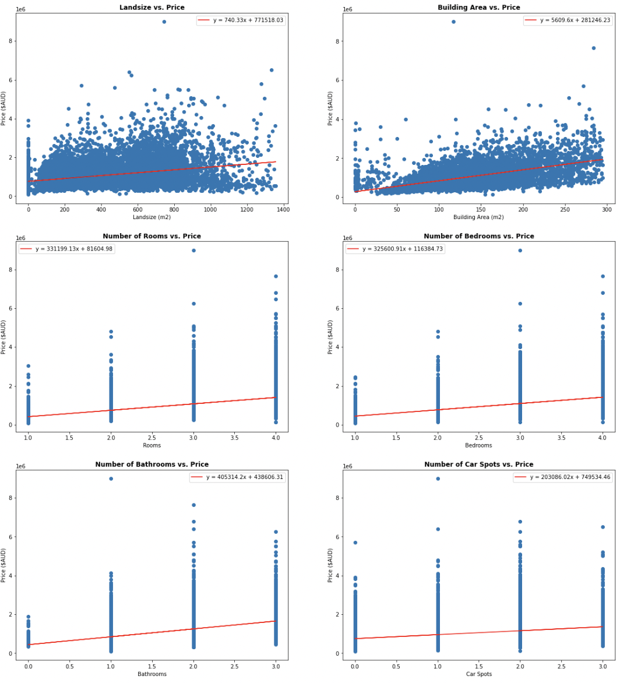
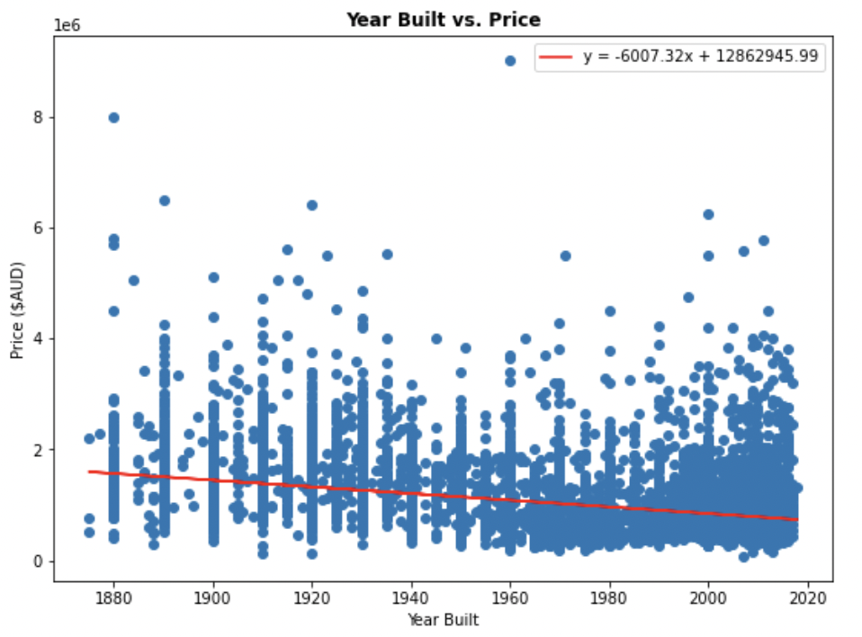
QUESTION 1.
Data Analysis: Dependent Nominal Variables
Continuous Variables
Ordinal Variables

Slide 11
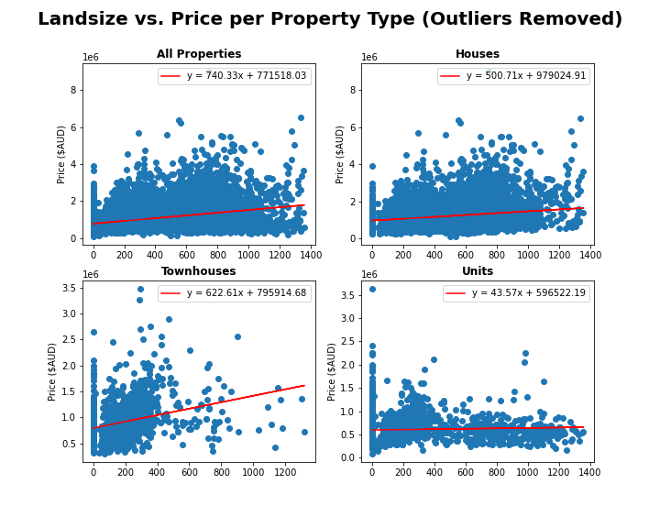
QUESTION 1.
Data Analysis: Dependent Nominal Variables
Correlation Values
All
House
Townhouse
Unit
0.339
0181
0.280
0.048

Slide 12
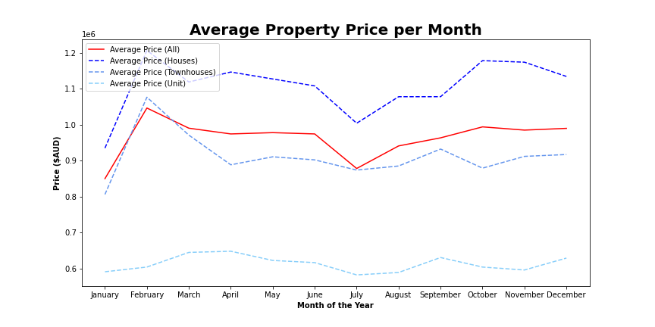
QUESTION 1.
Data Analysis: Date of Sale

Slide 13
QUESTION 2.
Looking to buy in Melbourne? What location is best for you and your bank account

Slide 14
Q2: Looking to buy in Melbourne? What location is best for you and your bank account
Parameters Used:
Distance from CBD
Location
Target Demographic
Property Type – Unit (u), Townhouse (t), House (h)

Slide 15
QUESTION 3.
Looking to sell in Melbourne? Which real estate agency will get you the best value?

Slide 16
QUESTION 3.
Parameters Used:
Number of properties sold
Performance of price above average (Z-score average)
Location-based performance
Method of Sale

Slide 17
QUESTION 3

Slide 18
Final summary of implications
(Enter points for conclusion)

